Slide 1
Lab 6 – Atmospheric Stability
TA: Hannah Daley
aosc.umd.edu/~hmdaley/AOSC201

Slide 2
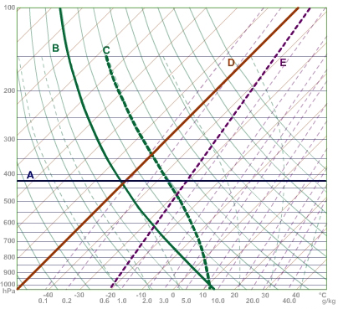
Isobars (A)
Isotherms (D)
Dry adiabats (B)
Saturated adiabats (C)
Mixing Ratios (E)

Slide 3
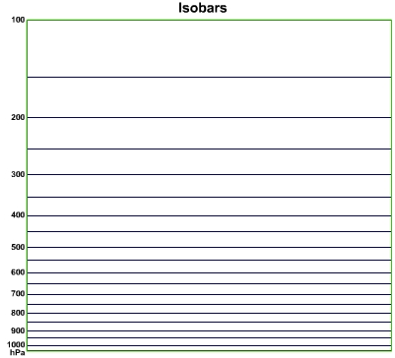
Isobars: lines of constant pressure Horizontal lines As elevation increases, pressure decreases Ground is approx. 1000mbar

Slide 4
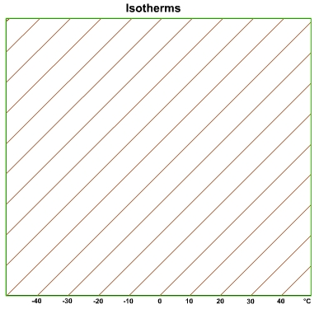
Isotherms: lines of constant temperature right leading diagonal lines

Slide 5
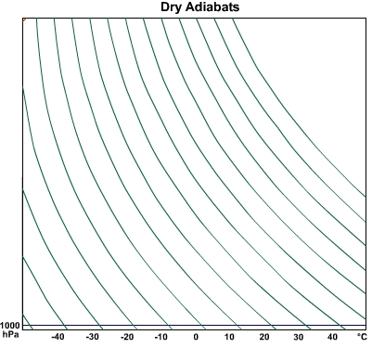
Dry adiabats can tell us how a parcel will be heated or cooled when lifted (change in pressure). Curved, left ward diagonal lines (10֯C/Km)

Slide 6
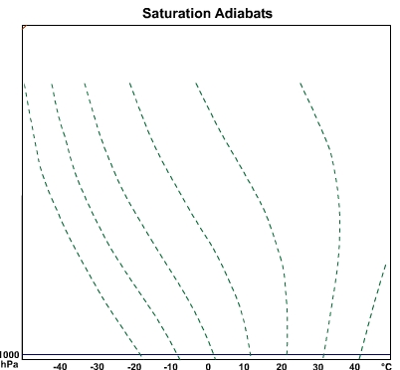
-Saturated (moist) adiabats tell us how a saturated parcel will be heated or cooled when lifted.
-Differ from dry adiabatic lapse rate due to latent heating from condensation
-Solid lines that have a different rate depending on temperature and pressure. The rate is Inversely proportional to temperature and directly related to pressure.

Slide 7
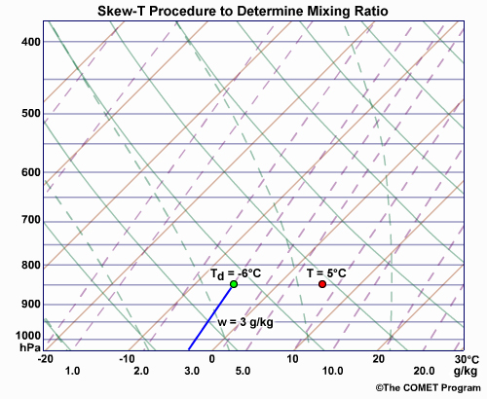
Mixing Ratio is the amount of water vapor(g) per kg of air.
Find by taking the intersection of the mixing ratio line and the dew point temperature.
Dashed lines leaning to the right. #2 of the Lab

Slide 8
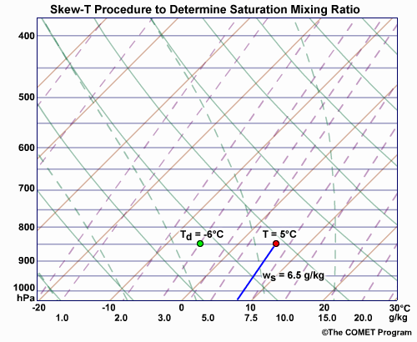
Saturated Mixing Ratio is the maximum amount of water vapor(g) that can be held per kg of air.
Find by taking the intersection of the mixing ratio line and the environmental temperature.
Dashed lines leaning to the right. #3 of the lab

Slide 9
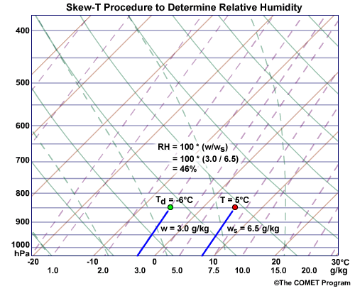
Relative Humidity
Relative humidity (RH) is the ratio (expressed as a percent) of the amount of water vapor in a given volume of air to the amount that volume would hold if the air were saturated.
RH = 100 * (w/w_{s})
#4 of the lab. Answer in tenth place.

Slide 10
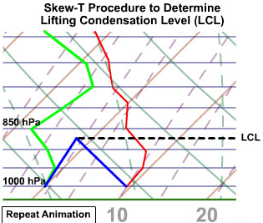
Lifting Condensation Level LCL
The lifting condensation level (LCL) is the height at which a parcel of air becomes saturated when it is lifted dry-adiabatically.
Some examples of lifting mechanisms include: cold fronts, orography, and convection.

Slide 11
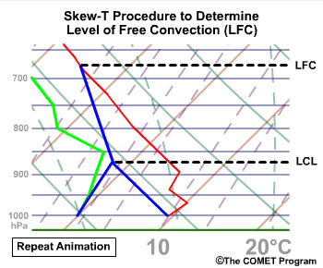
Level of Free Convection LFC
The height at which a parcel of air, when lifted, becomes warmer than its surroundings and thus convectively buoyant.

Slide 12
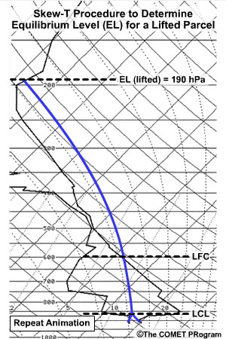
Equilibrium Level EL
The height where the temperature of a buoyantly rising parcel again equals the temperature of the environment.
May represent cloud ‘top’

Slide 13
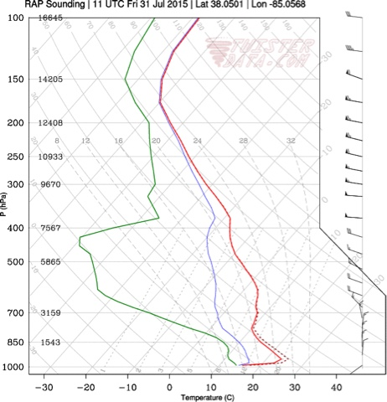
Radiation/Nocturnal Inversion
Occurs overnight
Surface is cooling and emitting heat energy (infrared), making the surface layer cooler than the air above.
Closest to Surface

Slide 14
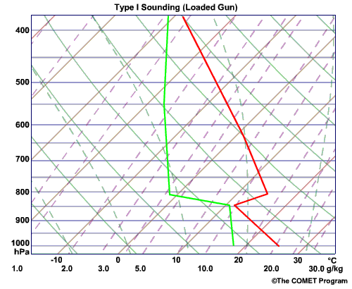
Capping Inversion/Subsidence
Occurs in the troposphere if there is sinking air
Air cannot rise above this inversion
Second of the three inversions you are looking for

Slide 15
Tropopause inversion
Normally occurs between 100 mb and 250 mb (highest of the three)
Air cannot rise above this inversion
Note that inversions are areas where temperature is constant or increases with height. The tropopause inversion tends to be when temperature is constant

Slide 16
Ex for #6: Lapse Rates
Ex. -30 degrees Celsius at 300mb (third one down on your lab)
Pick a second point ~2km above the first, staying parallel to the moist adiabats
We can now calculate the lapse rate:
= -(T₂-T₁)/(H₂-H₁)
= -(-48-(-30))/(11-9)
= 9 degrees C/km

